Slide 1

Oasis
Stevens Institute of Technology
Anjali Paliwal, Kristin Kim, Gavin Snyder, Andy Molla

Slide 2
Problem to Solve
Lack of media coverage on the availability of social welfare programs and homeless shelters
Not knowing how to properly search for needed services or amenities
Lack of women-oriented design towards finding services/amenities
Notes:
[SCORE SHEET]
1) Problem to be solved adequately stated? This includes identification of stakeholders including target user population and the buyers of your system which may be different from users

Slide 3
Why Oasis?
Easy Search satisfying a specific need that caters to women such as
“allow children”, “offers toiletries”, “women-only”, “provide meals”, “provide education”, etc.
Provide accurate contact information
Direct access to social services
National Domestic Violence Hotline
Facilitate the community open board

Slide 4



Target User Population
Designed for women in need (homeless, domestic issues, etc.)
Hoboken, Jersey City, and NYC area

Slide 5

Stakeholders
Services or amenities in the Hoboken, Jersey City, and NYC area
The women in need (target population)
Service we have made initial contact with (pending a response): Hoboken Shelter
Notes:
ANJALI

Slide 6
Requirement Process
Initial base set of ideas for what to include (based off research and personal challenges in attempting to find resources nearby):
Map with search/filtering to aid in finding nearby places with resources that match needs/wants
Understand that some shelters do not offer certain amenities women would like, such as allowing families or pets, providing toiletries, etc.
Accurate contact information
Finding many women online asking for access to shelter in wrong areas (ex. Forums that are not checked frequently)
Community-based rating
Women supporting women-- based off our research women typically have harder time finding places because they don’t feel comfortable/safe, so ratings made by other women can help address this issue
Notes:
ANJALI
My sorority was attempting to identify womens centers at Stevens/Hoboken area, but were not having much luck. There are some in the Jersey City/NY area, but even then we found it difficult to easily find those. This led to the initial idea that there needs to be a direct map that offers search/filtering capabilities to find places nearby with resources that match needs/wants of women. The reason for this is so women do not have to call every service asking if they have this or that, and instead we do that for them easily.
We also identified a need for accurate contact info, simply by finding women asking on random boards for access to shelters. This indicates that there are women who do not have a clear idea on how to best contact a shelter/service to receive help seamlessly.
Moreover, we found that overall the reason women find it difficult to be sheltered is because they do not feel comfortable/safe in some of them due to a variety of reasons, some of which may be related to past trauma as well. By creating a platform where women give ratings to shelters, it allows shelters to improve while also allowing women to gain an understanding of which shelters other women feel are safest.
[SCORE SHEET]
2) Requirement Process explained.

Slide 7
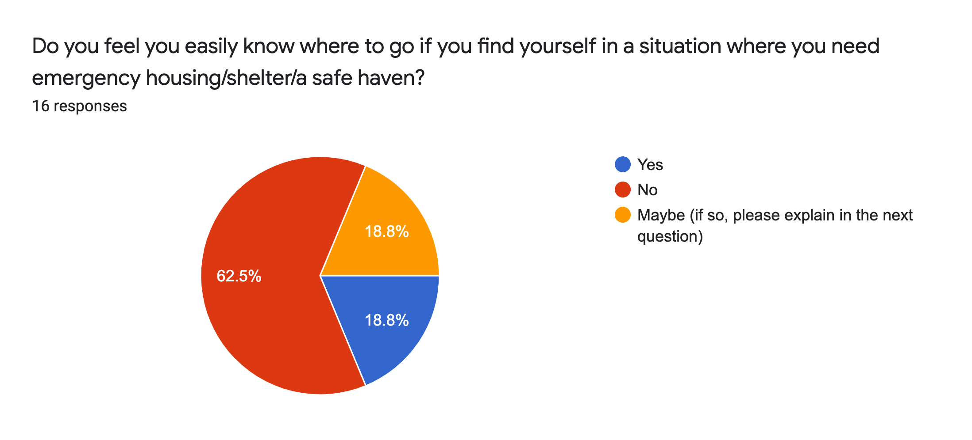
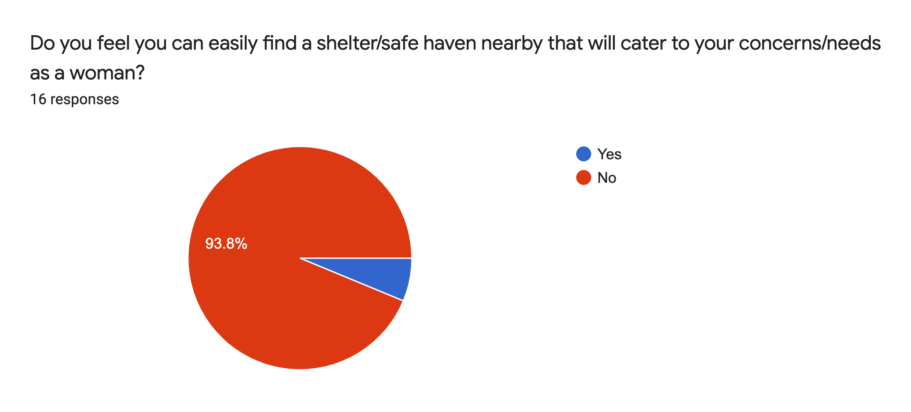
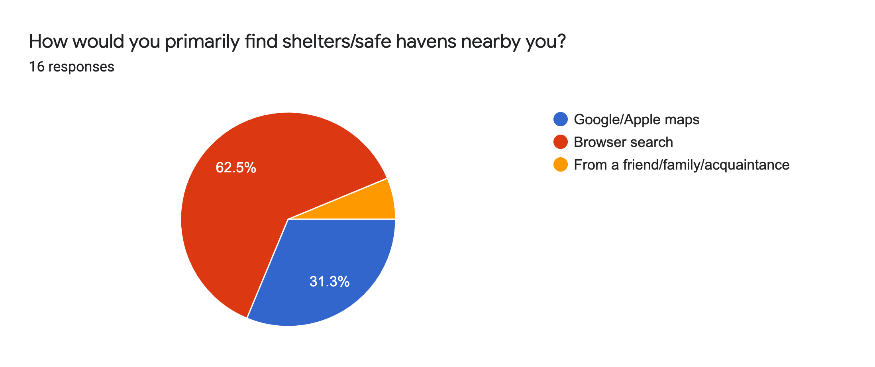
Requirement Process
2) Anonymous Survey gauging women’s opinions on being able to locate services near them
93.8% indicate they do not feel they can easily find shelter that caters to their needs as women
Additional concerns that will be addressed as new requirements/proof of need for current requirements:
How to reach the shelter/haven
Women don’t seek out shelters until too late
Lack of knowledge of concept of women shelter/haven
Security as a woman in a shelter is difficult to find
No knowledge of shelters in safe areas
Next steps:
Check with more stakeholders to see how these ideas align with their needs/wants, and determine more requirements to build on top of the basic idea of finding services/amenities nearby
Notes:
ANJALI
We then conducted an anonymous survey which gained 16 responses to see how women currently feel about being able to find shelters that suit their needs. We found that nearly 94% of respondents did not feel they can easily find shelter, indicating the need for our project, and we obtained new information on requirements through the survey as well.
Our next steps are checking with stakeholders to see how our platform’s ideas align with their needs/wants, and to determine more requirements to build on top of the basic idea of finding services/amentieis nearby, or to even see if our current set needs to be tweaked in some way.
[SCORE SHEET]
2) Requirement Process explained.

Slide 8




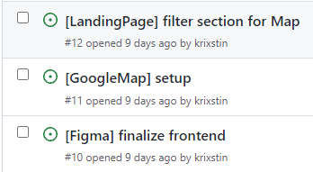

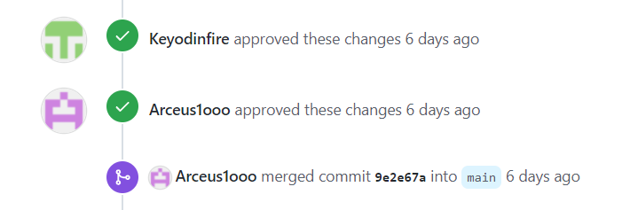
Development and Governance Environment
Version Control System: Git
Languages: Javascript, HTML, CSS
Platforms: React, Google Map API, Firebase, Figma
Project Lead/Product Owner: Anjali
Full-stack developers: All
Governance Strategies
Minimum of 2 reviews for accepting changes
Kanban Project Board
Todo -> In progress - > Done
Detailed issues on specific area of tasks
[Google Auth], [Stakeholders], [Landing Page], etc.
Notes:
Kristin
[SCORE SHEET]
3) Description of Development and Governance Environment used.Will you rotate leadership?

Slide 9

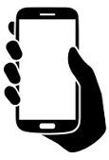


Software/Hardware Standards
Software:
Language(s)
HTML, CSS, JavaScript
Software packages/libraries used with release/version number
React 17.0.2,
Firebase version 9(NoSQL database)
Google Map API version 3.46
Code conventions
HTML: https://www.w3schools.com/htmL/html5_syntax.asp
CSS: https://www.phpied.com/css-coding-conventions/
JS: https://www.w3schools.com/js/js_conventions.asp
• Hardware:
Development Hardware
PC
Test Hardware
PC, mobile (iOS, Android)
Target/Deployment Hardware
PC
Mobile (iOS, Android)
Will be decided based on users’ survey
Notes:
Kristin
[SCORE SHEET]
4) Description of Standards

Slide 10
Demo
Notes:
[SCORE SHEET]
5) Quality of Demo

Slide 11

Thank you for listening

